Slide 1
Automated grading of prostate cancer using convolutional neural network and ordinal class classifier
Sara Khosravi
October 2021

Slide 2
Overview
Published in 2019 in Elsevier BV
Cited 18 times
Written by Indian researchers

Slide 3
Overview
Most of the existing techniques are able to distinguish between high-grade and low-grade PCa only, not between all of the 5 grade groups.
Even though the winning method of PROSTATEx-2 challenge achieved a fair quadratic weighted kappa score, it was unable to predict any cancer belonging to GG 4.
No existing method reported a moderate quadratic weighted kappa score (above 0.40).

Slide 4
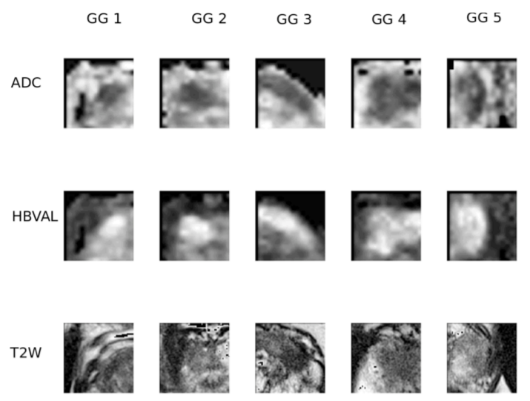
Dataset
Train: PROSTATEx-2, publicly available
Dataset of the PROSTATEx-2 2017 challenge
An expert radiologist identified suspicious lesions in each MRI and assigned a PI-RADS score.
Employed T2W, high B-Value DWI (HBVAL)
and ADC images from the dataset
Fig1. PROSTATEx-2 dataset sample

Slide 5
Dataset
Test dataset could not be incorporated: it’s ground truth is not made public yet.
Overcome this limitation: performed Leave-One-Patient-Out (LOPO) cross-validations on train dataset after dividing it into training and test sets

Slide 6
Methods
6

Slide 7
Preprocess
Ground truth of the PROSTATEx-2 dataset is a voxel point roughly placed at the tumor’s center
The ground truth of ADC and HBVAL images were (38, 66, 5) and that of T2W was (175, 197, 6).
A region of interest (ROI) of size 15 x 15 x 3 surrounding the ground truth was selected from HBVAL and ADC
An ROI of dimension 60 x 60 x 3 from T2W images
(3 contiguous slices were chosen, which is represented by 3 in the ROI size)
(The dimension of T2W varies from that of the other modalities, due to the image acquisition resolution
A volume of dimension 224 x224 x 3 was prepared from each of the ADC, HBVAL, and T2W images as an input to NN

Slide 8
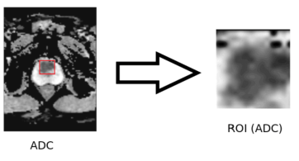
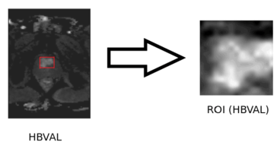
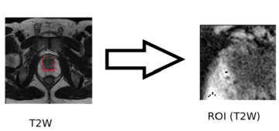
Preprocess
Fig.2 : The ground truth of ADC and HBVAL images were (38, 66, 5) and that of T2W was (175, 197, 6). An ROI of size 15 x 15 x 3 surrounding the ground truth was selected from ADC and HBVAL images and an ROI of size 60 x 60 x 3 was selected from T2W images. We have indicated the region containing the lesion in red color.

Slide 9
Preprocess
ROI of size 224 x 224 x 3 generated from ADC, HBVAL and T2W images are passed as input to the VGG-16 network.
To obtain the feature representations of the input images, activations are applied on the last fully connected layer consisting of 1000 neurons.
Three feature vectors of dimension 112 x 1000 each are constructed from ADC, HBVAL, and T2W images. A feature vector of size 112 x 3000 is produced by concatenating the 3 feature vectors.

Slide 10
Preprocess
Principal Component Analysis (PCA) is used to bring down the size of the feature vector to 112 x 32.
Dimensionality reduction is achieved by choosing enough eigenvectors to account for 85% of the variance in the original data. 32 eigenvectors are chosen by the PCA algorithm implemented in WEKA.
PCA is applied to the feature vector extracted from the whole dataset.

Slide 11
Methods
Feature extraction with VGG-16 and J48 classifier
Multiclass classification
We used an Ordinal Class Classifier associated with
WEKA as the classifier for the proposed technique

Slide 12
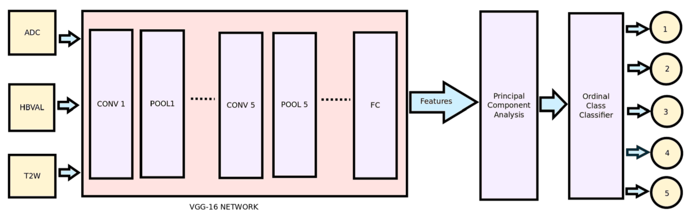
Methods

Slide 13
Evaluation

Slide 14
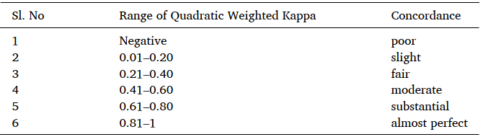

Results
Metric: the quadratic weighted kappa score
Reached 0.47 moderate score
Higher QWKS than all other methods
Training instances were significantly less in grade groups 4 and 5.
Have not performed any data augmentation techniques for enhancingthe size of the training data.
Fig3. Interpretation of quadratic weighted kappa.

Slide 15

Results
A quadratic weighted kappa reflects the degree of disagreement, in such a way that more emphasis is given to bigger differences among ratings than to minor differences.
The quadratic weighted kappa is suitable for ordinal class classification.
It is a suitable performance metric for extremely disproportioned data as in PROSTATEx-2, whereas accuracy is a misleading performance measure in such cases
Fig4. Model results

Slide 16
Thanks For Your Attention
Any Questions?
Contact: srkhsrv21@gmail.com

